Slide 1
Access 2016 Module 3
Using Forms

Slide 2
Module Objectives
Use the Form Wizard
Create a split form
Use Form Layout View
Add fields to a form
Modify form controls
Create calculations
Modify tab order
Insert an image

Slide 3
Use the Form Wizard (Slide 1 of 2)
A form is an Access database object that allows you to arrange the fields of a record in any layout so you can enter, edit, and delete records
One way to create a form is by using the Form Wizard
The wizard asks you questions to determine the information you want
Database designer or application developer responsible for building and maintaining tables, queries, forms, and reports
Each item on a form is called a control
Label control (describe data shown in other controls)
Text box (display data)
Combo box (combination of a text box and a list)

Slide 4
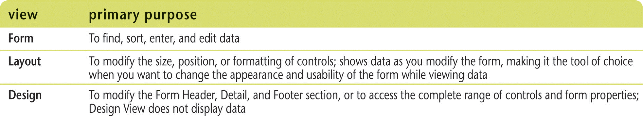
Use the Form Wizard (Slide 2 of 2)
Form views

Slide 5
Create a Split Form (Slide 1 of 3)
Benefit of a split form
upper pane allows you to display the fields of one record in any arrangement
lower pane maintains a datasheet view of the first few records, which you can navigate very quickly

Slide 6
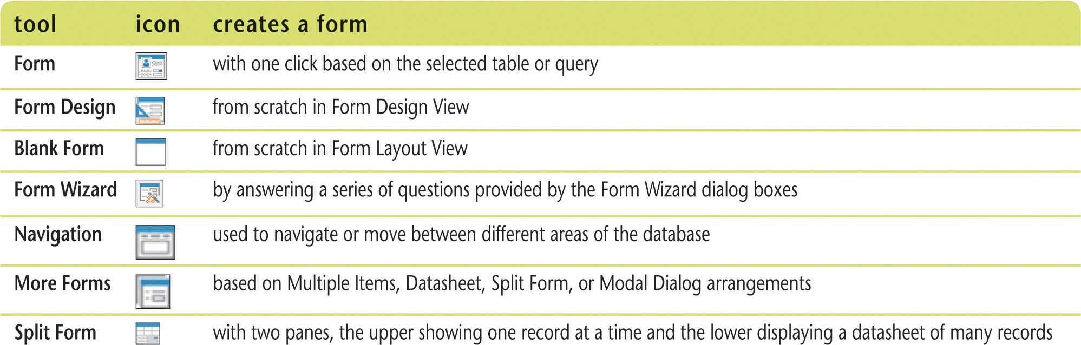
Create a Split Form (Slide 2 of 3)
Form creation tools

Slide 7
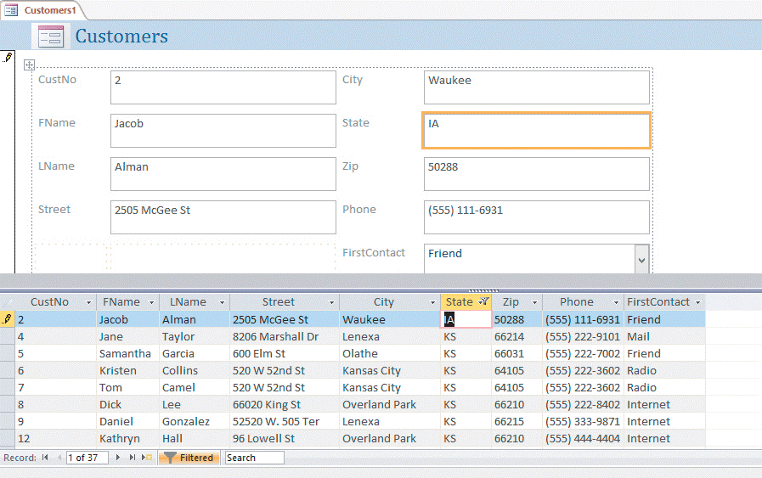
Create a Split Form (Slide 3 of 3)
Table in a split form

Slide 8
Use Form Layout View (Slide 1 of 3)
Layout View lets you make some design changes to a form while you are browsing the data:
Move and resize controls
Add or delete a field on the form
Filter and sort data
Change formatting characteristics, such as fonts and colors

Slide 9
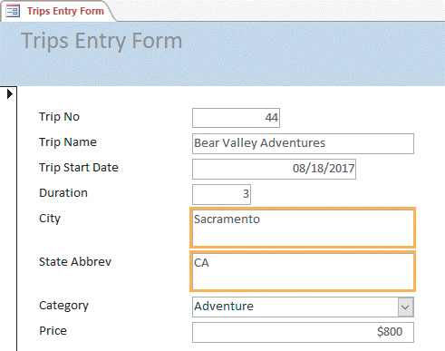
Use Form Layout View (Slide 2 of 3)
Modifying controls in Form Layout View
Text boxes resized

Slide 10
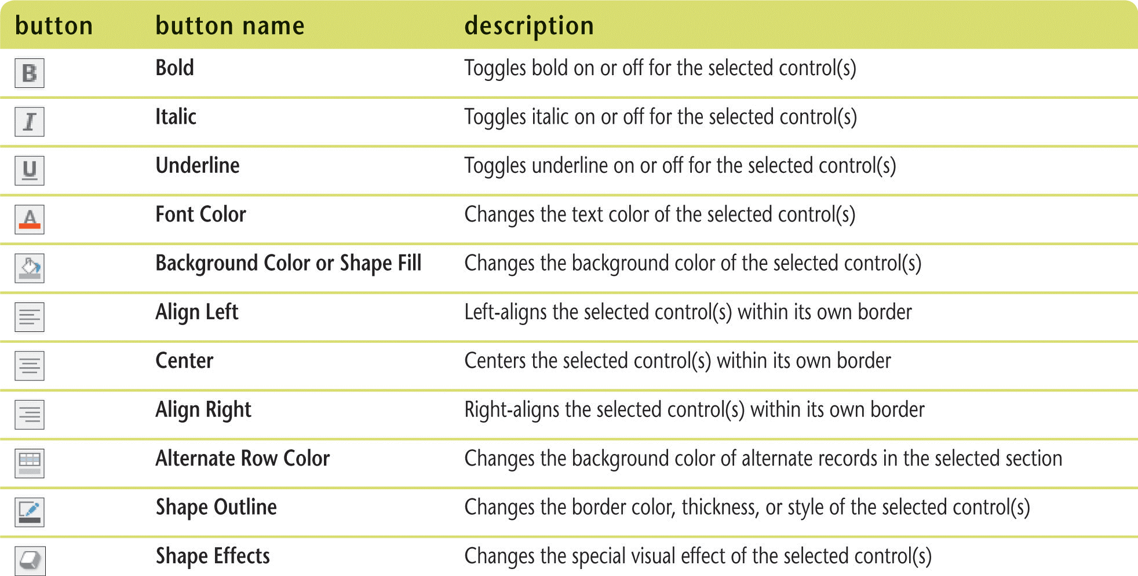
Use Form Layout View (Slide 3 of 3)
Useful formatting commands

Slide 11
Add Fields to a Form (Slide 1 of 3)
Can do in Layout View or Design View using Field List window
To add a field: drag it from the Field List to the location you want
When you add a new field, two controls are created: label and text box
To delete a field: click to select the field, then press [Delete]

Slide 12
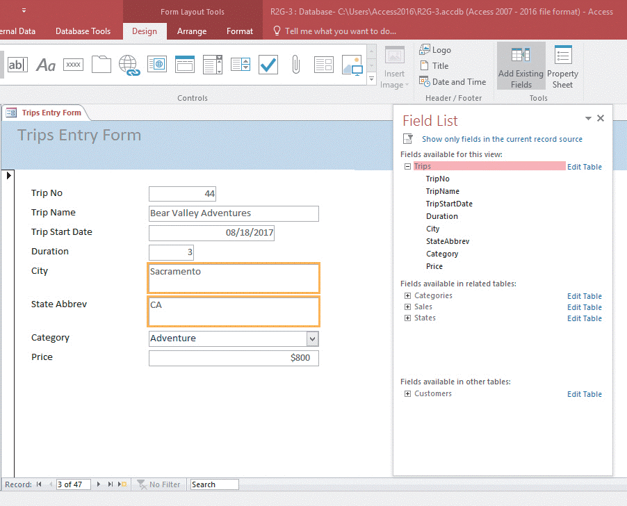
Add Fields to a Form (Slide 2 of 3)
Field List in Form Layout View

Slide 13
Add Fields to a Form (Slide 3 of 3)
Bound controls
Display values from a field such as text boxes and combo boxes
Unbound controls
Do not display data
Describe data or enhance the appearance of a form

Slide 14
Modify Form Controls (Slide 1 of 3)
When you modify controls, you change their properties (characteristics)
All of the control characteristics you can modify are stored in the control’s Property Sheet

Slide 15
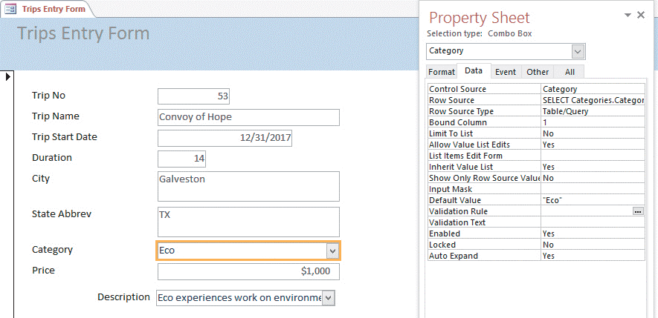
Modify Form Controls (Slide 2 of 3)
Using the Property Sheet

Slide 16
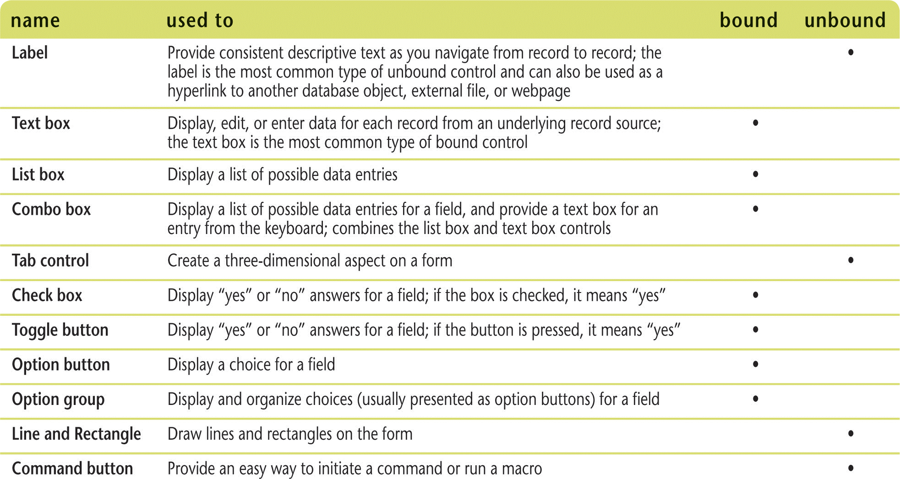
Modify Form Controls (Slide 3 of 3)
Common form controls

Slide 17
Create Calculations (Slide 1 of 3)
To create a calculation in a text box, you enter an expression instead of a field name in the Control Source property
An expression is a combination of field names, operators (such as +, –, /, and *), and functions (such as Sum, Count, or Avg) that results in a single value
Expression: an equal sign and a combination of symbols
Square brackets must surround a field name in an expression
Field name must be typed exactly as it was in Table Design View (except for capitalization)

Slide 18
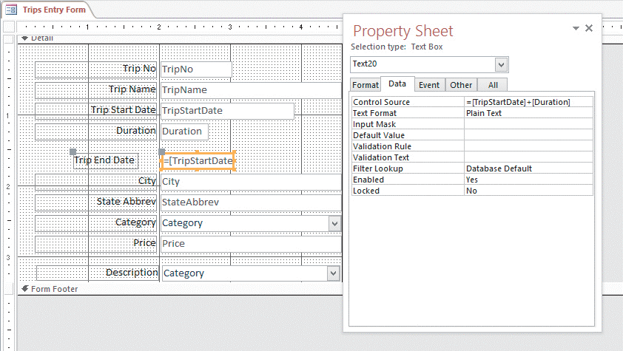
Create Calculations (Slide 2 of 3)
Adding a text box to calculate a value

Slide 19
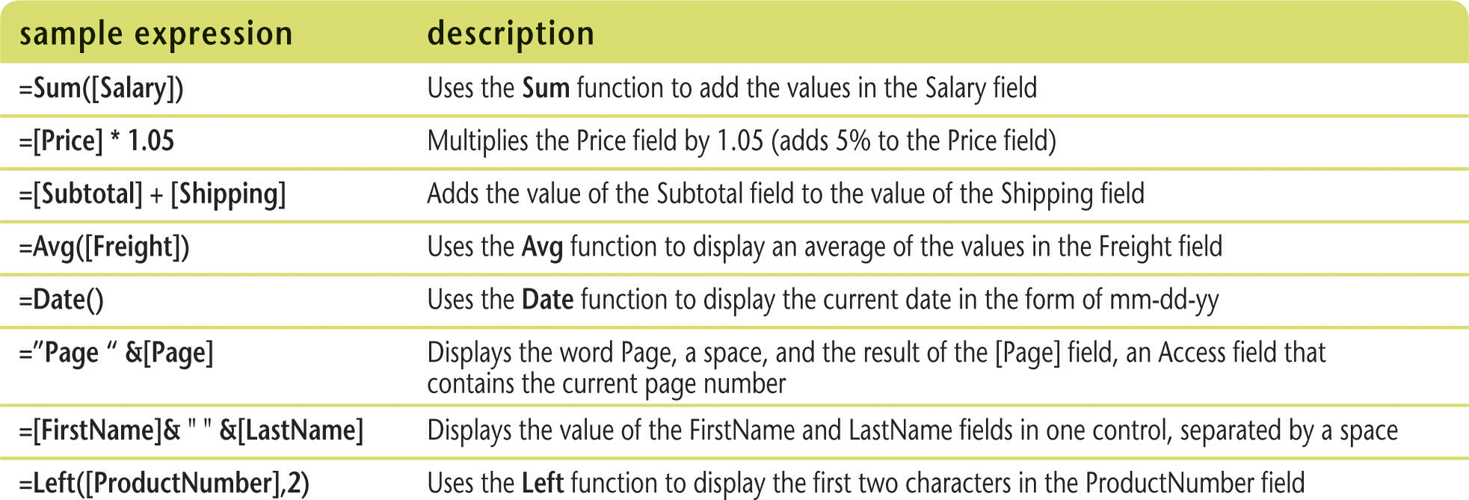
Create Calculations (Slide 3 of 3)
Sample expressions

Slide 20
Modify Tab Order (Slide 1 of 2)
Tab Order: the order the focus moves as you press [Tab]
Tab Stop: determines whether the field accepts the focus and therefore determines where the focus moves as you press [Tab]
All text boxes and combo boxes have a tab stop and are included in the tab order

Slide 21
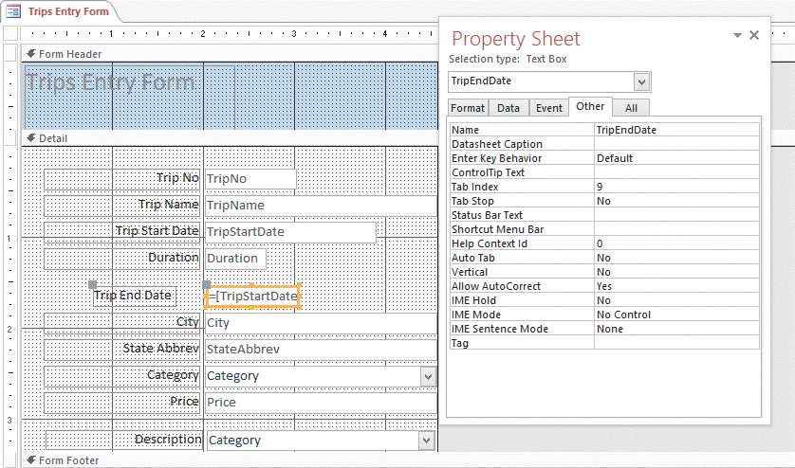
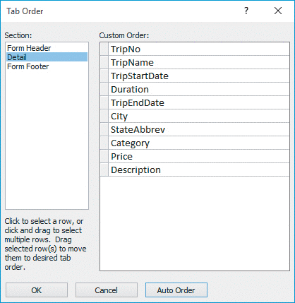
Modify Tab Order (Slide 2 of 2)
Setting tab properties
Tab Order Dialog Box

Slide 22
Insert an Image (Slide 1 of 2)
Examples are pictures, logos, clip art
The form section you place it in determines where it will appear on the form
Form Header – once at top of first page
Detail – once for every record
Form Footer – once at the end of the last page
Background image
Fills the entire form or report appearing “behind” other controls

Slide 23
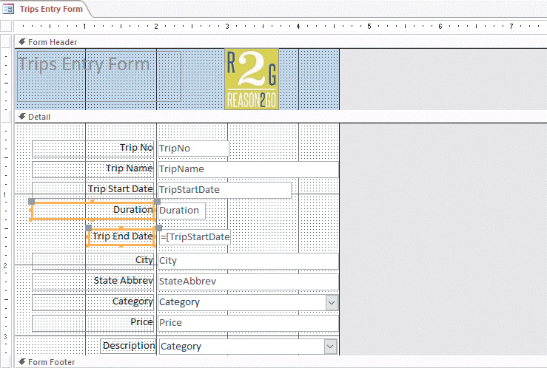
Insert an Image (Slide 2 of 2)
Adding an image to Form Header section

